Slide 1


Exploring the King’s Outcome Scale for Childhood Head Injury in Children Attending a Rehabilitation Hospital
Peter Rumney¹ MD; Ryan Hung¹ MD; Laura McAdam¹ MD; Arthur Ameis² MD; Michel Lacerte³ MD; Pierre Cote⁴ Ph.D; David Cassidy⁵ Ph.D; Eleanor Boyle⁵ Ph.D; Dayna Greenspoon¹ MSc(OT)
Holland Bloorview Kids Rehabilitation Hospital¹, University de Montreal², Western University³, University of Ontario Institute of Technology⁴, University Health Network
IBIA-March 2016; Netherlands. April 2016 – Toronto - Practical Strategies Conf.
Holland Bloorview Kids Rehabilitation Hospital, Toronto ON, Canada
ACRM 91st Annual Conference, Toronto ON, Canada

Slide 2

Disclosure
Dr. Rumney has no financial interest to disclose.
The research that has been done has been funded through a Research Grant #11-44
from the PSI Foundation
(Physician Services Incorporated - Toronto)

Slide 3
Background: Reason for Outcome Measures
Traumatic Brain Injuries (TBI):
  Common cause of future disability in children (Sharples, 1998)
  Risk for lifelong cognitive, behavioural and physical impairments (Thomas-Stonell, Johnston, Rumney, et al., 2006)
  Important to:
    Evaluate effectiveness of treatment programs
    Determine level of disability in children so appropriate resources can be available to provide support (Government and Third Party)
  Clinicians need a reliable and valid method of measuring disability after pediatric brain injury
Notes:
Evaluate effectiveness of treatment programs by measuring outcomes
Catastrophic injuries, particularly in pediatrics requires ongoing care and community supports

Slide 4
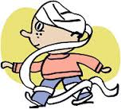
Background:
Outcome Measurement Considerations in Pediatrics
Outcome measurement in pediatric brain injury:
  Must be cognizant of ongoing neurodevelopmental changes in the brain
  Questions and response categories must be age appropriate
  Functional Activities should be the focus of assessment as opposed to evaluation of dysfunction, physical impairment alone
Notes:
Head injury lit commonly focuses on adult population- but measures for adults can not always be applied to ped population – Ciurea, A.V., Sandu, A.M., Popescu, M., et al. (2008). Neurotrauma pediatric scales. Journal of Medicine and Life, 1, 403-414.
Example: a question about child's ability to dress in the morning would not be appropriate for a child under the age of two, for a slightly older child- some assistance would be appropriate, and for a child over the age of ten it would not be normal to require assistance with dressing
Another NB issue is validity of attitudinal-based scales: clinician completing a measure after interviewing the parent and observing the child complete a task may be very different from how the parent/child would rate it- NB to have both perspectives
Haley S.M., Graham R.J., Dumas H.M. (2004). Outcome rating scales for pediatric head injury. Journal of Intensive Care Medicine, 19, 205-219.

Slide 5
King’s Outcome Scale for Childhood Head Injury (KOSCHI)
  Developed by Crouchman and colleagues (2001)
  Adaptation of the Glasgow Outcome Scale
  Target:
    “ to provide a robust, simple description of outcome after pediatric TBI in the short, medium or long term” (Crouchman, Rossiter, Colaco, & Forsyth, 2001, p. 120)
Short term (weeks)
Medium term (months)
Long term (years)
Pediatric Brain Injury Outcome
Notes:
Crouchman M., Rossiter L., Colaco T., & Forsyth, R. (2001). A practical outcome scale for paediatric head injury. Archives of Diseases in Childhood, 84, 120-124 .
- Scale developed with a population of children attending inpatient and outpatient – 200 children over a 7 year period
Can be completed by conducting a clinical examination or auditing medical record
Supposed to place emphasis on behavior, concentration and disinhibition, and is sensitive to changes in the mild range of disability

Slide 6
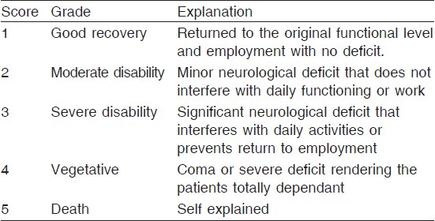
Comparison with the Glasgow Outcome Scale and its Variants
Jennett & Teasdale : Management of Head Injuries 1981 pg. 306

Slide 7
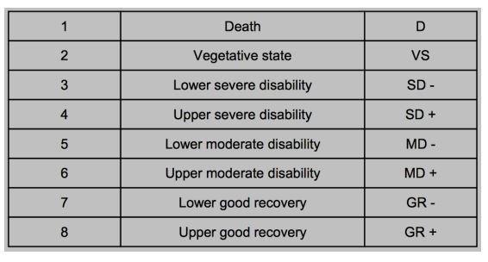
Glasgow Outcome Scale Extended
February | 2015 | Peripheral Brainpbrainmd.wordpress.com
MODIFIED RANKIN SCALE (MRS)

Slide 8
Pediatric GOS-E
Beers, Wisniewski et al – J.of Neurotrauma 29:1126-1139
(Apr. 2012)
1)Consciousness No (Veg State) /Yes -> 2
2)Independence in the Home No /Yes -> 3
  Activities of Daily Living
    Need for frequent help from Caregiver
    No/Yes (Lower Severe Dis/ Upper Severe Disability)
3)Independence Outside of the Home No/Yes ->4
  Ability to shop and travel without assistance
    Behave age appropriately outside of the home No/Yes -> 4
    (Upper Severe Disability)
4) School/Work – Can the child Fx in school/work at previous capacity No/Yes ->5
  Reduced work or school capacity No/Yes (Lower Mod/Upper Mod. Disability)
  Able to work only in sheltered workshop or school for severely impaired children

Slide 9
5) Social & Leisure Activities: Child able to resume regular Social/School Activities No/Yes -> 6
  What extent of restrictions on social/leisure Activity
    Rarely or Unable to Participate (Lower Mod. Disability)
    Participates Much less often < 50% ( Upper Mod. Disability)
    Participates somewhat less often > 50% ( Lower Good Recovery)
6) Family & Friendships – Are there psychologic problems that result in disruption No/Yes -> 7
  Constant Disruptions – Daily (Lower Mod. Disability)
  Frequent – Weekly or more (Upper Mod. Disability)
  Occasional – Less than Weekly ( Lower Good Recovery)
7) Return to Normal Life No/Yes (Lower/Upper Good Recovery)

Slide 10
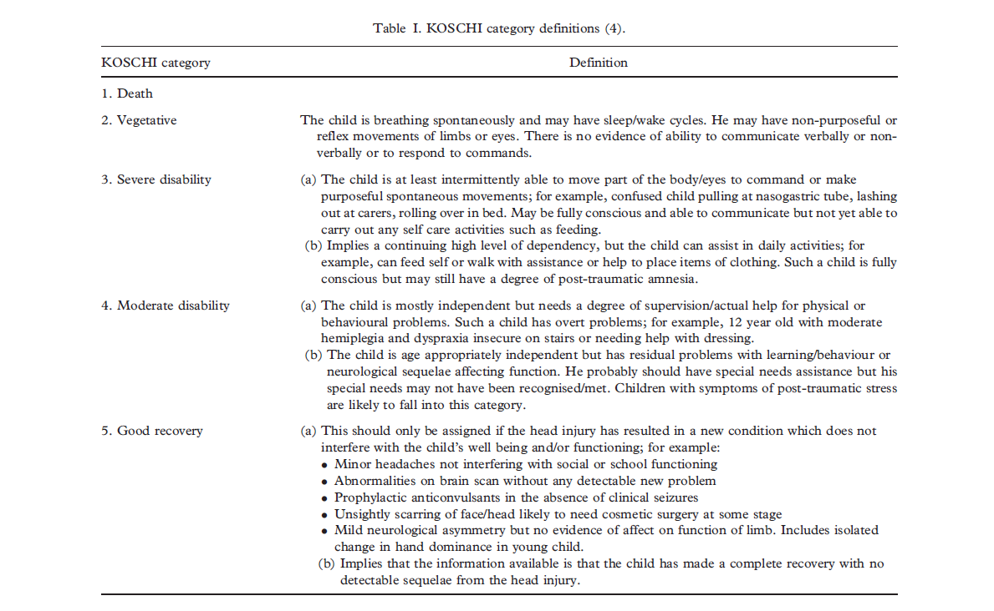
KOSCHI
Table 1. KOSCHI category definitions. Taken from: Paget., S.P., Beath, A.W.J, Barnes, E.H., & Waugh, M.C. (2012). Use of the King’s Outcome Scale for Childhood Head Injury in the Evaluation of Outcome in Childhood Traumatic Brain Injury. Developmental Neurorehabilitation, 15(3), 171-177.

Slide 11
KOSCHI- What does the literature say?
  Limited data on its psychometric properties (Crouchman et al., 2001; Hawley et al., 2003; Calvert et al. 2008; Shashikiran et al., 2012)
    Retrospective chart review methodology
    Moderate reliability (inter-rater)- kappa ~0.51
    Variable convergent validity with quality of life and cognition measures when used as a one-time measure
  Paget, Beath, Barnes, & Waugh (2012):
    Moderate to good inter-rater reliability – weighted kappa 0.71
    Longitudinal follow-up:
      Half -no change in KOSCHI score
      Younger then 8 years of age (at time of injury): scores worsened over time in 23% of cases
      Older than 8 years: no scores worsened over time
Notes:
16 Paget., S.P., Beath, A.W.J, Barnes, E.H., & Waugh, M.C. (2012). Use of the King’s Outcome Scale for Childhood Head Injury in the Evaluation of Outcome in Childhood Traumatic Brain Injury. Developmental Neurorehabilitation, 15(3), 171-177.
Mod reliability:
Crouchman et al- mod inter-rater- six raters, each with diff educational backgrounds including a non clinician- kappa 0.51; might be reason for low kappa. Authors also say scale could be treated as interval instead of ordinal but sample only contained one vegetative and two severely disabled children.– once removing these three children, scores on koschi highly correlated with total functional score on mobility, communication, behaviour, disinhibition, danger awareness, self care and cognition. Paper did not report demographic data, type of ABI, length of time since inj/ill so hard to generalize
Calvert et al. 2009- 81 children aged 5 to 16 with mild, mod, severe tbi defined by GCS- two raters reviewed outpatient notes– KOSCHI moderately correlated to other measures of injury severity such as GCS, length of stay and PTA.
Variable correlations to measures of cognition (Wechsler intelligence scale for children's verbal IQ) and health related quality of life measures + PedsQL
Good correlation between discharge KOSCHI and early measures of cog function (intellect and attention); strength of relation weak with exception of discharge KOCHI and verbal IQ; little relation between discharge KOSCHI and cog outcome 6 months or more after injury; weak correlation between KOSCHI at discharge and attention measures; no correlation between discharge KOSCHI and executive function
Koschis done one month and six months post injury. Majority of koschi scores at six mo were either mod disability or good recovery 5a.- few children in severe disability and no children in vegetative state– not heterogeneous enough to test validity. Also time since injury may have been too short to see change- as it takes some time for ped brain injuries to recover.
Applied to various types of ABI- shaken baby syndrome, intracerebral hemorrhage, subdural hemorrhage, raised intracranial pressure. Also outcomes post decompressive craniotomy in children, hypothermia treatment

Slide 12
KOSCHI- What does the literature say?
Casselden, Kirkham, & Durnford (2014)- Abstract
  Examined inter-rater reliability of Glasgow Outcome Scale Extended- Peds (GOS-E) and KOSCHI
  GOS-E Peds: Poor agreement (k=0.19) at discharge, fair agreement (k=0.47) at follow-up
  KOSCHI: Fair agreement at discharge (k=0.26) and follow-up (k=0.31)
    Combining subcategories of major outcome groups for KOSCHI: inter-rater reliability
Notes:
Medical student and MD
Study suggests that if kappa of 0.41 is considered adequate than GOSE-E at follow-up is considered satisfactory, but KOSCHI is only satisfactory when subcategories are considered together
When subcategories collapsed- kappa on follow-up is consistent with previously reported literature.
If you look at where are discrepancies are in our pilots…its not only between levels (mod/severe) or (mod/mild) but also within…so likely variability would be reduced in our pilots should we collapse
Study recommends further assessment of reliability in peds brain injury with increased sample size and raters of different specialties and grades
→And this is what we are doing→ prospective, large sample size, pediatricians, pediatric neurologists and physiatrists.
Casselden, E., Kirkham, F.J., Durnford, A.J. (2014). Inter-rater reliability of two outcome scoring tools in paediatric head injury [abstract]. Archives of Disease in Childhood, 99 (suppl 1), A1-A212.

Slide 13
Research Objectives:
To examine:
  The inter-rater and intra-rater reliability of the KOSCHI among children attending a rehabilitation hospital with acquired brain injuries
  Compare KOSCHI with other validated measures of overall health status (MPAI and PedsQL)
  The responsiveness of the KOSCHI

Slide 14


Participants: Inclusion and Exclusion
Inclusion:
Youth between the ages of 4 to 18 years
English speaking families
Diagnosed with an acquired brain injury
Exclusion:
Children diagnosed with an acquired brain injury as a result of:
  surgical complications for the treatment of epilepsy
  have any developmental disorders
  have progressive inflammatory encephalopathy
A total of 200 youth were recruited from a post-acute inpatient pediatric rehabilitation facility with long-term follow-up

Slide 15
Method: Pilot Studies
Literature Review
Pilot 2 (N=10)
Modify KOSCHI Data Collection Form and Scoring Algorithm
Develop KOSCHI Data Collection Form
Modify KOSCHI Data Collection Form; Develop scoring algorithm
Full Study (N=180)- Prospective Cohort Study
Pilot 1 (N=10)
Continuing Education Re: KOSCHI Scoring
Notes:
Develop Data Collection Form:
Form tested in clinical setting by two pediatricians and one pediatric neurologist
Modifications made based on feedback by pediatricians, two community physiatrists and an occupational therapist
Pilot 1 and Pilot 2 Process:
Pediatrician assessed children with brain injury in clinic
Completed a KOSCHI data collection form and assigned a KOSCHI score for each child
Two pediatric physicians and two community adult physiatrists independently reviewed the completed KOSCHI data collection forms and assigned KOSCHI scores (scoring algorithm used to aid scoring in pilot 2)
Each physician was blinded to each other’s scores
Full Study:
Same procedure as pilots- but daypatient, inpatient and outpatient
Daypatients and inpatients are assessed on admission and 72 hours later
All youth re-evaluated 6 months to a year later
Family completes demographics, pedsQL and MD does MPAI

Slide 16
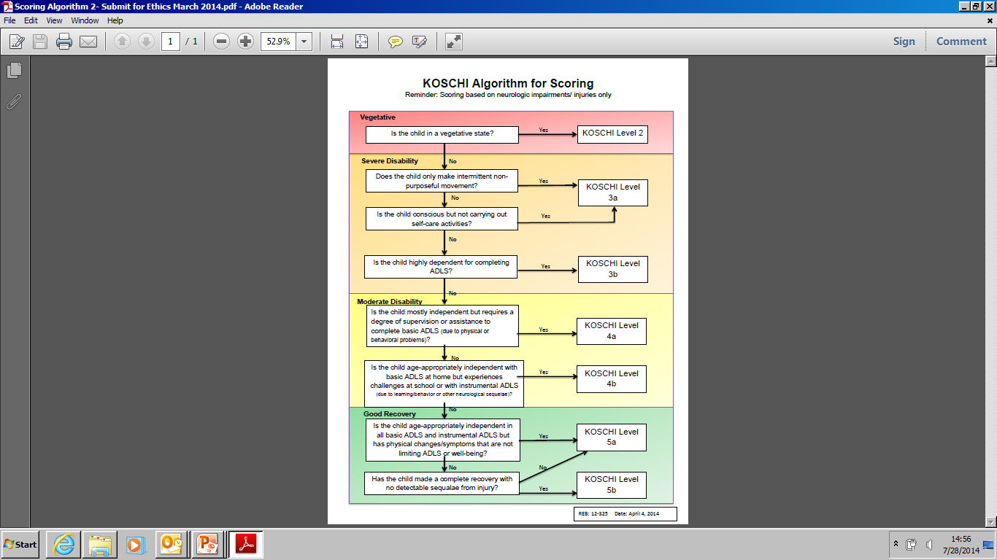
KOSCHI Scoring Algorithm:

Slide 17

Other Health Outcome Measures
Mayo- Portland Adaptability Inventory (MPAI) (Pediatric Adaptation) (Malec et al., 2003)
The Pediatric Quality of Life Scale (PedsQL)
(Varni et al., 1999)
Notes:
Oddson B, Rumney, P., Johnson, P., Thomas-Stonell, N. (2006). Clinical use of the Mayo-Portland Adaptability Inventory in rehabilitation after pediatric acquired brain injury. Developmental Medicine and Child Neurology, 48: 918-922

Slide 18
Methods: Full Study
Inpatient/Day patient Baseline
A pediatrician completes:
Outpatient Baseline
A pediatrician completes:
Two physiatrists score KOSCHI from data collection form
A second pediatrician scores KOSCHI from data collection form
Two physiatrists score KOSCHI from data collection form
in-person ax & KOSCHI data collection form
Family completes PedsQL and demographic form
Severity indicators collected
in-person ax & KOSCHI data collection form
Severity indicators collected
MPAI
KOSCHI Score
Family completes PedsQL and demographic form
MPAI
KOSCHI Score
A pediatrician completes:
Two physiatrists score KOSCHI from data collection form
Follow-Up (6 mo to 1.5 yrs)
in-person ax & KOSCHI data collection form
KOSCHI Score
MPAI
Family completes PedsQL and demographic form
Scoring is blinded
Intra-Rater Reliability
(random sample)

Slide 19
Results: Demographics
 | Frequency
Gender Male Female | 130 70
Type of Injury Traumatic Mild Moderate Severe Non-Traumatic | 104 24 22 58 96
Table 1. Gender and Injury Type
Figure 1. Cause of Injury

Slide 20
Results: KOSCHI Score Frequency
Figure 2. Distribution of in-person KOSCHI scores at baseline by the primary pediatrician (N=180)
Notes:
highlights the distributions of KOSCHI scores from the in-person clinical interview completed at the initial assessment (baseline) by the primary pediatrician in charge.

Slide 21
Results: Inter-rater Reliability
 | Weighted Kappa (95% CI ) | Spearman Correlation
Pediatrician to Pediatrician
In-person Assessment to Chart Review
Inpatient/Daypatient Baseline | 0.54 (0.4-0.67) | 0.69
In-person Assessment to Form Derived
Outpatient Baseline | 0.63 (0.53-0.73) | 0.82
Outpatient Follow-Up | 0.71 (0.51-0.91) | 0.83
Inpatient/Daypatient Follow-Up | 0.68 (0.51- 0.86) | 0.86
Physiatrist to Physiatrist
Form Derived to Form Derived
Outpatient Baseline | 0.69 (0.59-0.79) | 0.85
Outpatient Follow-Up | 0.64 (0.48-0.80) | 0.83
Inpatient/Daypatient Baseline | 0.47 (0.32-0.62) | 0.68
Inpatient/Daypatient Follow-Up | 0.69 (0.51-0.87) | 0.99
Table 3. Weighted Kappa's; CI= Confidence Interval
Notes:
Inter-rater reliability, as measured by weighted kappa's and inverse variance kappa's, was found between pediatrician to pediatrician, physiatrist to physiatrist and pediatrician to physiatrist. Table 2 outlines the weighted kappa's for inter-rater reliability between pediatrician to pediatrician (in-person assessment to chart review and in-person assessment to form derived) and physiatrist to physiatrist (form derived to form derived).

Slide 22
Results: Inter-rater Reliability
 | Inverse Variance Kappa
Pediatrician to Physiatrist
In-Person Assessment to Form Derived
Outpatient Baseline | 0.65
Outpatient Follow-Up | 0.64
Inpatient/Daypatient Baseline | 0.52
Inpatient/Daypatient Follow-Up | 0.61
Form Derived to Form Derived
Outpatient Baseline | 0.80
Outpatient Follow-Up | 0.88
Inpatient/Daypatient Follow-Up | 0.73
Table 4. Inverse Variance Kappa's
Notes:
Table 4 displays the kappa's derived from the inverse variance method for the inter-rater reliability between pediatricians to physiatrists (in-person assessment to form derived and form derived to form derived).

Slide 23
Results: Inter-rater Reliability (Scoring Discrepancies)
 | 2 | 3a | 3b | 4a | 4b | 5a | 5b
2 | 1 | 0 | 0 | 0 | 0 | 0 | 0
3a | 0 | 8 | 5 | 0 | 1 | 0 | 0
3b | 0 | 4 | 15 | 8 | 0 | 0 | 0
4a | 0 | 0 | 4 | 11 | 2 | 0 | 0
4b | 0 | 0 | 0 | 3 | 1 | 1 | 0
5a | 0 | 0 | 0 | 0 | 0 | 0 | 0
5b | 0 | 0 | 0 | 0 | 0 | 0 | 0
Table 5. Discrepancies in KOSCHI Scores among Pediatricians (Baseline, Inpatient/Daypatient, In-Person to Form Derived); n=64
Notes:
Table 5 provides a breakdown of the discrepancies in KOSCHI scoring (in-person assessment to form derived scores) among the pediatricians at baseline assessment for youth recruited from the inpatient/daypatient program. The largest number of discrepancies occurred at the 3b/4a level and 3a/3b level.

Slide 24
Results: Intra-Rater
 | n | Weighted Kappa (95% CI) | Spearman
Physiatrist 1 | 16 | 0.92 (0.78-1.06) | 1.00
Physiatrist 2 | 16 | 0.81 (0.62-1.01) | 0.90
Pediatrician 1 | 13 | 0.89 (0.7-1.08) | 0.98
Pediatrician 2 | 12 | 0.89 (0.67-1.11) | 0.92
Pediatrician 3 | 12 | 0.69 (0.38-1.00) | 0.83
Table 6. Intra-Rater Reliability for Outpatient Data
Notes:
Intra-rater reliability was substantial for pediatrician 3 and almost perfect for the remaining physicians, as measured by weighted kappas. Each physician re-reviewed 12 to 16 scripts for the purposes of intra-rater reliability. The weighted kappas and 95% confidence intervals are reported in table 3.

Slide 25
Results: Comparison of KOSCHI to Other Measures of Overall Health Status
Spearman Correlation:
KOSCHI- PedsQL:
0.68
KOSCHI-MPAI:
-0.87
Figure 3. Convergent Validity of KOSCHI
Notes:
The relationship between the KOSCHI scores and mean scores on the PedsQL and MPAI were examined. The distribution is displayed in Figure 6. Examination of baseline KOSCHI scores in relation to PedsQL and MPAI scores reveals spearman correlations of 0.68 and -0.87 respectively.

Slide 26
Results: Change in KOSCHI Scores- Baseline to Follow-Up
Follow-Up Duration: 0.85 years (mean); 0.34 (SD)
Follow-Up KOSCHI Scores
 | 2 | 3a | 3b | 4a | 4b | 5a | 5b | Totals
2 | 0 | 0 | 0 | 0 | 0 | 0 | 0 | 0
3a | 0 | 2 | 6 | 1 | 1 | 0 | 0 | 10
3b | 0 | 0 | 3 | 2 | 3 | 1 | 0 | 9
4a | 0 | 0 | 0 | 3 | 6 | 1 | 0 | 10
4b | 0 | 0 | 0 | 1 | 14 | 5 | 0 | 20
5a | 0 | 0 | 0 | 0 | 0 | 0 | 0 | 0
5b | 0 | 0 | 0 | 0 | 0 | 0 | 1 | 1
Baseline KOSCHI Scores
Figure 4. Change in KOSCHI scores over time (N=50)
Notes:
The KOSCHI scores for youth who completed follow-up (were assessed on more than one occasion) were examined for their responsiveness to change. Specifically, the results were examined with respect to whether the KOSCHI score showed change over time. Approximately half of the children (46%, 23 of 50) showed no change in KOSCHI score from baseline to follow-up, 26 children had an improvement in their KOSCHI score, and one youth’s KOSCHI score decreased . Changes in KOSCHI score over time were then compared to changes in scores on the PedsQL and MPAI as seen in Figure 4.

Slide 27

Discussion
Agree with previous literature: KOSCHI is easy to score retrospectively from medical records (Crouchman et al., 2001, Calvert et al., 2008, Paget et al., 2012)
  Easy to score from in-person assessment
Addition of a KOSCHI data collection form and scoring algorithm did not improve reliability substantially
Moderate inter-rater reliability (consistent with previous literature) (Crouchman et al., 2001, Calvert et al., 2008, Paget et al., 2012)
Good intra-rater reliability
Highest inter- and intra- rater reliability when scoring from data collection form
Notes:
Inter-Rater and Intra-Rater Reliability
Moderate to good inter-rater reliability was found, consistent with previous literature^{2,3,4}
Highest inter-rater agreement found when scoring was completed by review of the KOSCHI data collection forms only
This is likely due to consistency in the information used to derive a score
Information gained from in-person assessment that is used to derive a score may not be accurately captured in the data collection form
Addition of the scoring algorithm and data collection form did not significantly improve inter-rater reliability
Majority of discrepancies occurred at the moderate and severe levels of disabilities and consisted of one level differences (e.g., 3a/3b, 3b/4a)
Good to very good intra-rater reliability for all pediatricians and physiatrists
Convergent Validity
KOSCHI demonstrated strong and very strong correlations with the PedsQL and MPAI respectively
Correlation with the family’s perceived quality of life was not as strong as with the physician’s scoring of the functional outcome measure
Responsiveness
KOSCHI demonstrated the ability to identify changes in function over time. However, the KOSCHI is devised as a nominal scale and therefore a one step change does not necessarily mean the same at each level for the recovery of function.
Limitations: This study was limited by the number of follow-ups that were completed and the inability to have a second in-person assessment for KOSCHI scoring.
Conclusion: KOSCHI can be reliably used to categorize the level of disability in acquired brain injury population. This tool is more appropriate for use with the pediatric population compared to the Glasgow Outcome Scale –Extended (GOS-E). Critical appraisal of the KOSCHI versus the GOS-E needs to be pursued.

Slide 28
Discussion
Previous literature raised concern re: need for clarification of the differences in subcategories
  Past literature shows improved kappa with collapsing subcategories (e.g., Casselden et al., 2012)
  But lose sensitivity to important clinical changes
  Do not need to collapse subcategories to get reasonable inter-rater reliability
Good correlation with the other overall measures of outcome
  Correlation with the family’s perceived quality of life (PedsQL) is not as strong as with the physician’s scoring of the functional outcome measure (MPAI)

Slide 29

Limitations and Next Steps
Limitations
  Number of follow-ups
  Inability to have a second in-person rating
Next Steps
  Consider amending the scale
    Greater clarification of the subcategory differences
    In higher functioning levels (4b, 5a) factors outside of function influence scoring (e.g., minor headaches, abnormalities on brain scan, scarring)

Slide 30
References:
Sharples M. Head Injury in Children. In: Little R, Ward PM, eds. Injury in the young. Cambridge: Cambridge University Press, 1998: 263-99.
Thomas- Stonell, N., Johnson, P., Rumney, P. et al. (2006). An evaluation of the responsiveness of a comprehensive set of outcome measures for children and adolescents with traumatic brain injuries. Journal of Pediatric Rehabilitation Medicine, 9, 14-23.
Haley S.M., Graham R.J., Dumas H.M. (2004). Outcome rating scales for pediatric head injury. Journal of Intensive Care Medicine, 19, 205-219.
Crouchman M., Rossiter L., Colaco T., & Forsyth, R. (2001). A practical outcome scale for paediatric head injury. Archives of Diseases in Childhood, 84, 120-124.
Bond, M.R. (1990). Standardized methods of assessing and predicting outcome. In Rosenthal, M., Griffith, E.R., Bond, M.R., & Miller, J.D (Eds.). Rehabilitation of the adult and child with traumatic brain injury – Edition 2 (pp. 59-74). Philadelphia: F.A Davis Company.
Shashikiran, S., Maduri, R., Williamson, S., Sabherwal, S., & Margo, E. (2012). King’s Outcome Scale for Childhood Head Injury score in severe traumatic brain injury and its relation to injury severity and medical intervention [abstract]. Brain Injury, 26 (4-5), 309-799.
Paget., S.P., Beath, A.W.J, Barnes, E.H., & Waugh, M.C. (2012). Use of the King’s Outcome Scale for Childhood Head Injury in the Evaluation of Outcome in Childhood Traumatic Brain Injury. Developmental Neurorehabilitation, 15(3), 171-177.
Calvert, S., Miller, H.E., Curran, A., et al. (2008). The King’s Outcome Scale for Childhood Head Injury and injury severity and outcome measures in children with traumatic brain injury. Developmental Medicine and Child Neurology, 50, 426-431.
  Casselden, E., Kirkham, F.J., Durnford, A.J. (2014). Inter-rater reliability of two outcome scoring tools in paediatric head injury [abstract]. Archives of Disease in Childhood, 99 (suppl 1), A1-A212.
  Oddson B, Rumney, P., Johnson, P., Thomas-Stonell, N. (2006). Clinical use of the Mayo-Portland Adaptability Inventory in rehabilitation after pediatric acquired brain injury. Developmental Medicine and Child Neurology, 48: 918-922
  Varni JW, Seid M, Rode CA. The PedsQL: measurement model for the pediatric quality of life inventory. Med Care 1999; 37:126-39.

Slide 31
Thank you
Contact: prumney@hollandbloorview.ca

Slide 32
Results: Severity Indicators
 | Mean; SD (N)
Age of Initial Ax (years) | 12.8; 4.1 (200)
Age at Injury (years) | 8.7; 5.5 (200)
Time from Injury to Ax (years) | 4.1; 4.6 (200)
Hospital Length of Stay (days) | 26.1; 24.839 (160)
ICU Length of Stay (days) | 10.1; 11.3 (98)
Ventilation Duration (hours) | 201.9; 271.5 (83)
Post Traumatic Amnesia (hours) | 220.3; 363.9 (61)
Number of Previous Brain Injuries | 2.7; 2.6 (16)
Glasgow Coma Scale | 7.7; 3.7 (66)
 | Frequency
Previous Brain Injury Yes No Do Not Know | 16 182 2
Surgery for Brain Injury Yes No Do Not Know | 91 101 8
Coma on Admission Yes No | 65 135
Table 2a. Severity Indicators (Mean and Standard Deviation)
Table 2b. Severity Indicators (Frequency)

